Slide 1
Session's objectives
Get familiar with Azure Cosmos DB core concepts and data modeling best practices
Apply them to a real-world scenario
Understand how Azure Cosmos DB differs from relational databases when designing a data model
Notes:
Mention that the session is only 45-minute-long so we'll only take questions at the end.

Slide 2
What is Azure Cosmos DB?
Microsoft's NoSQL database on Azure
Non-relational and
horizontally scalable

Slide 3



What is Azure Cosmos DB?
horizontally scalable
Unlimited throughput
Unlimited storage capacity
Notes:
When working with Azure Cosmos DB – and unless your workload is very trivial (low amount of data stored and low throughput requirements) – your data will likely be stored on a number of different physical servers. This is something that's abstracted by our concept of "containers", but under the hood you're usually dealing with a cluster of servers.
And that's how we achieve horizontal scalability, by enabling:
Unlimited storage (when you need more storage, we add more servers to your cluster)
Unlimited throughput (when you need more throughput, same happens)

Slide 4

What is Azure Cosmos DB?
non-relational
Notes:
When working with relational databases, you have the ability to define relational constraints between the different entities you're storing. This lets you define things like foreign keys between entity types and perform JOIN operations across these entity types.
Non-relational databases like Cosmos DB don't implement these relational constraints. Why?

Slide 5
What is Azure Cosmos DB?
non-relational
and
horizontally scalable
Notes:
As we explained, Azure Cosmos DB is a non-relational, horizontally scalable database.
That means your data isn’t stored on a single machine—instead, it is automatically distributed across many servers, which can scale from tens to hundreds or even thousands depending on your storage and throughput needs.
Because the data is distributed, Cosmos DB is optimized for fast, predictable performance and high availability. However, this also means Cosmos DB does not support traditional relational database features like foreign keys or joins that enforce constraints across multiple tables. Doing so across many servers would create performance bottlenecks and reduce availability—both of which contradict Cosmos DB’s design and SLA commitments.
So, for predictable, low-latency performance at global scale, Cosmos DB doesn’t expose mechanisms for enforcing relational constraints. Instead, applications model relationships differently—often embedding data or using denormalized document structures

Slide 6
So is Azure Cosmos DB suitable for relational workloads?
It sure is!
  Most workloads are actually relational
Need to use different techniques to implement relations between entities
Approach is very different from designing a data model for relational databases
  Most intuitions and best practices don't translate well and may even be anti-patterns!
Notes:
1️⃣ “It sure is! Most workloads are actually relational”
Cosmos DB can support relational-style scenarios (entities related to each other), such as:
- Orders and Customers
- Users and Devices
- Products and Categories
Most applications naturally contain relationships between data items, even if they don't live in a relational database.
Cosmos DB can model these relationships — but not with JOINs or foreign keys like SQL Server.
2️⃣ “Need to use different techniques to implement relations between entities”
Since Cosmos DB does not enforce relational constraints:
❌ No foreign keys
❌ No cascading deletes
❌ Cross-partition JOINs are expensive
You must use NoSQL modeling patterns, such as:
Embedding (denormalizing into one document)
Referencing (storing IDs and fetching separately)
Materialized views
Hierarchies and aggregates
Cosmos DB relational modeling is application driven, not schema driven.
3️⃣ “Approach is very different from designing a data model for relational databases”
What works in SQL Server can be an anti-pattern in Cosmos DB.
Examples:
❌ SQL intuition
Normalize everything → many tables → rely on JOINs
❌ What happens in Cosmos
Too many round trips
Too many cross-partition queries
High RU cost
✔ NoSQL intuition
Denormalize where needed
Optimize for how your app queries the data
Design for one-to-few or one-to-many patterns
This is why Cosmos DB data modeling requires rethinking the shape of data.

Slide 7
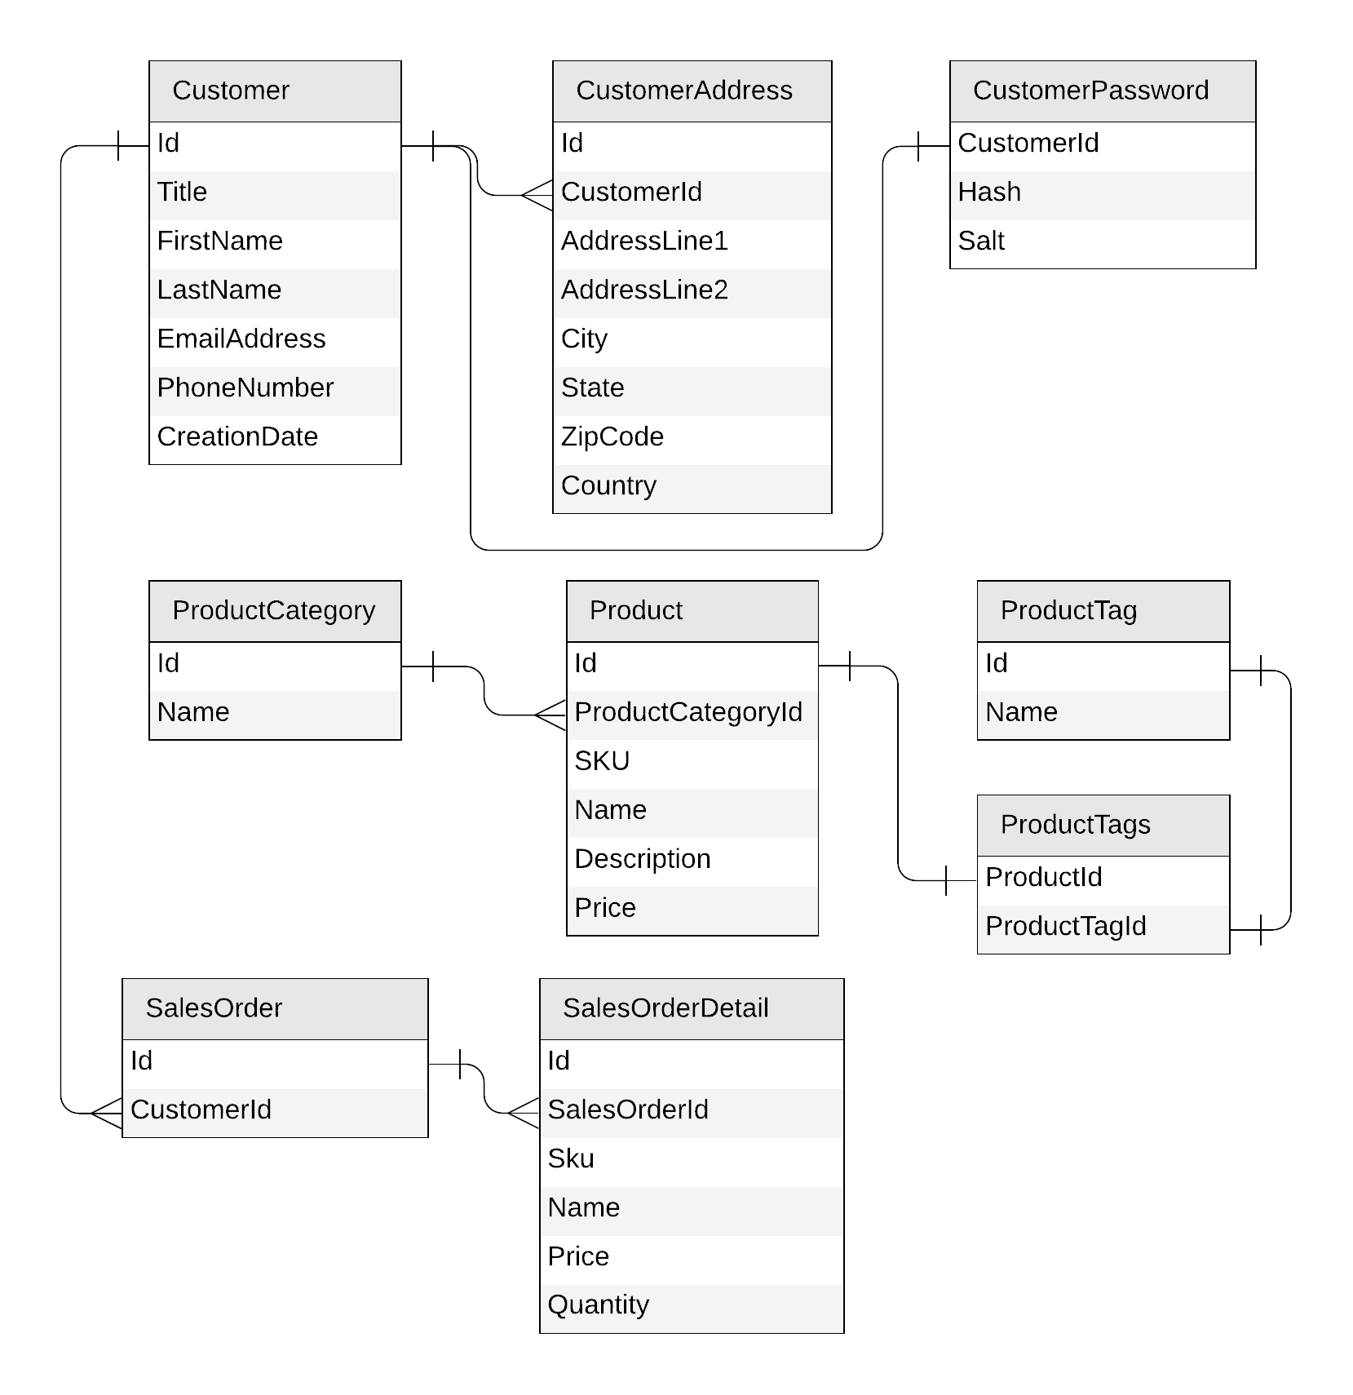
Let's look at a concrete example
E-commerce workload
Customers
Products
  Categories
  Tags
Sales Orders
Notes:
“Let’s walk through a concrete example that almost everyone recognizes — an e-commerce workload.
We typically have three main groups of data:
Customers
Products, along with categories and tags
Sales orders
On the right side, I’m showing the relational entity diagram — what we would normally design if we were using a SQL database like SQL Server.
If we were working with a relational system, this ER diagram would actually be enough to start designing our database schema. The relationships between tables — Customer to Addresses, Products to Categories, SalesOrder to SalesOrderDetails — give us a clear picture of how the data fits together.
However, when we switch to Cosmos DB, this diagram is still useful — but only for understanding the logical relationships between entities. Cosmos DB is a non-relational, document database, so we cannot rely on JOINs, constraints, or foreign key enforcement the same way we do in SQL.
Instead, what really drives our data model in Cosmos DB is how the application needs to access the data — its access patterns, query patterns, and transactional boundaries.
The relationships in the diagram help us understand the domain, but they don’t tell us:
which entities should be embedded together,
which ones should be referenced,
or how we should choose partition keys.
All of those decisions depend entirely on the patterns of how the application reads and writes data.
As we continue, you’ll see that many of our Cosmos DB modeling choices — such as embedding order details into the order document — come directly from understanding these access patterns rather than simply translating the ERD table-by-table.”

Slide 8
Identifying the operations we have to serve
Create a customer
Retrieve a customer
Create a product category
Edit a product category
List all product categories
Create a product tag
Edit a product tag
List all product tags
Create a product
Edit a product
List all products from a category
(with name of category and tags)
Create a sales order
List all sales order for a customer
List customers by descending number of sales orders
Notes:
A real e-commerce platform would obviously need to implement many more kinds of requests, but this subset is enough to guide our first implementation and illustrate the different design techniques we want to showcase.

Slide 9
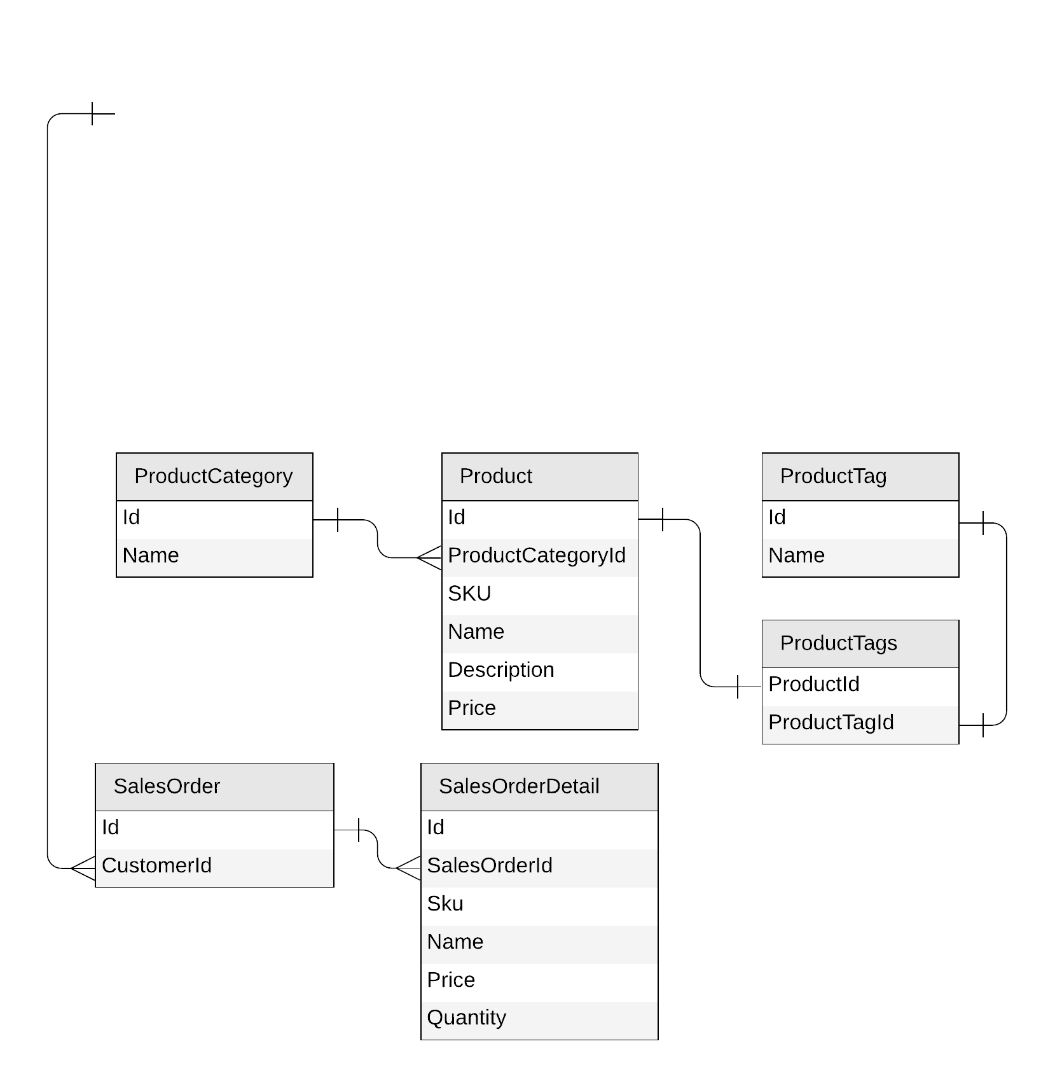
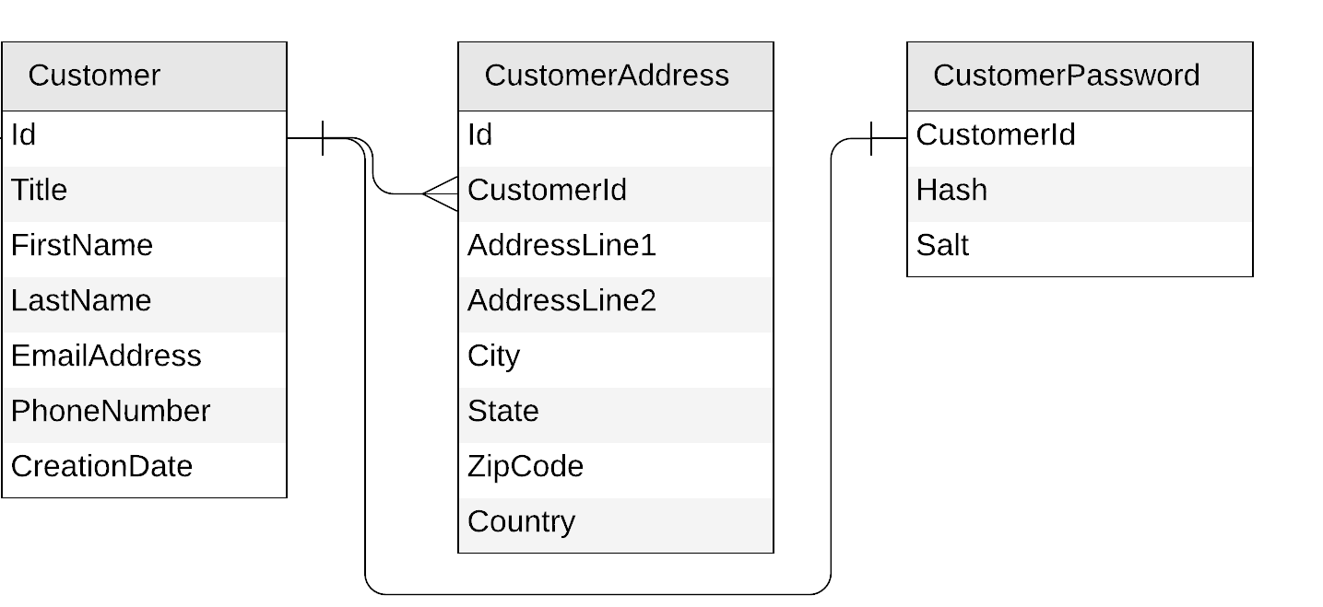
Now let's implement this model on Azure Cosmos DB!

Slide 10
Starting with the Customer entity
{
"id": "…",
"title": "…",
"firstName": "…",
"lastName": "…",
"emailAddress": "…",
"phoneNumber": "…",
"creationDate": "…"
}
{
"id": "…",
"customerId": "…",
"addressLine1": "…",
"addressLine2": "…",
"city": "…",
"state": "…",
"zipCode": "…",
"country": "…"
}
{
"id": "…",
"customerId ": "…",
"hash": "…",
"salt": "…"
}
Notes:
“Let’s start by looking at the Customer entity.
On the top, we see the relational model: a Customer table, a CustomerAddress table, and a CustomerPassword table. Each table has its own primary key, and they’re all connected through foreign keys.
If we were to take the most naïve approach to Cosmos DB, we might simply translate each table into its own JSON document — one JSON document for the customer, one for address, and one for password. That’s what you see at the bottom.
We’re keeping the relationships exactly the same as in SQL — the CustomerAddress document still points to the Customer with a customerId, and the CustomerPassword document also references the same customerId.
But notice that this isn’t leveraging Cosmos DB’s strengths yet.
This representation works, but it behaves very much like a relational system:
We still have references instead of embedding.
Queries now require multiple document lookups.
We have no guarantee of transactional consistency across these three documents.
This step is useful only as a baseline to understand the starting point.
In the next slides, we’ll explore how we can evolve this model into something better suited for Cosmos DB — by rethinking the shape of the data based on how it’s actually accessed.”

Slide 11
Starting with the Customer entity
{
"id": "…",
"title": "…",
"firstName": "…",
"lastName": "…",
"emailAddress": "…",
"phoneNumber": "…",
"creationDate": "…",
"addresses": [{
"addressLine1": "…",
"addressLine2": "…",
"city": "…",
"state": "…",
"zipCode": "…",
"country": "…"
}],
"password": {
"hash": "…",
"salt": "…"
}
}
Notes:
“Now let’s look at a much better way to model the Customer entity in Cosmos DB.
Because Cosmos DB stores JSON documents, we’re not limited to flat tables like in a relational database. We can take all the information related to a customer — their profile, their addresses, and even their password metadata — and store it together inside one single JSON document.
In this example, I’ve embedded:
An array of addresses, since a customer can have multiple addresses
A password object, since that’s a 1-to-1 relationship
This approach fits perfectly with Cosmos DB’s document model because:
We avoid joins — the entire customer record lives in one place
Retrieval becomes extremely fast and efficient
Consistency is simplified, because all related data is updated together
This is a great example of how we rethink data modeling when we move from relational to Cosmos DB:
Instead of splitting data across multiple tables, we design our JSON documents around how the application actually uses the data.”

Slide 12
To embed or to reference?
{
"id": "…",
"title": "…",
"firstName": "…",
"lastName": "…",
"emailAddress": "…",
"phoneNumber": "…",
"creationDate": "…",
"addresses": [{
"addressLine1": "…",
"addressLine2": "…",
"city": "…",
"state": "…",
"zipCode": "…",
"country": "…"
}],
"password": {
"hash": "…",
"salt": "…"
}
}
{
"id": "…",
"title": "…",
"firstName": "…",
"lastName": "…",
"emailAddress": "…",
"phoneNumber": "…",
"creationDate": "…"
}
{
"id": "…",
"customerId": "…",
"addressLine1": "…",
"addressLine2": "…",
"city": "…",
"state": "…",
"zipCode": "…",
"country": "…"
}
{
"id": "…",
"customerId ": "…",
"hash": "…",
"salt": "…"
}
Notes:
Now that we understand how JSON documents can be shaped, the next question is: should we embed data or reference it?
This slide shows three different ways we could model the Customer entity:
On the left, everything is embedded inside a single document — the customer profile, their addresses, and the password object.
In the middle, the customer document embeds some data but keeps addresses separate.
And on the right, we split everything into separate documents and link them using IDs — similar to how a relational database would work.
All three approaches are valid in Cosmos DB, but each comes with trade-offs. The key is to think about how your application actually accesses the data. Cosmos DB is optimized for scenarios where related data is stored together. But if something grows unbounded — like thousands of orders per customer — embedding becomes inefficient, and referencing makes more sense.
This slide is meant to show that the document model is flexible. You’re not forced into one approach — instead, you choose what fits your workload best.”

Slide 13
To embed or to reference?
Embed when:
1:1 relationship
1:few relationship
Related items are queried or updated together
Reference when:
1:many relationship (especially if unbounded)
Many:many relationship
Related items are queried or updated independently
Notes:
“Now let’s make this more concrete with simple rules.
Embed data when:
You have a 1-to-1 relationship
Or a 1-to-few relationship
And when the related items are usually queried or updated together
Embedding keeps the data co-located in the same physical partition, so lookups are fast and operations cost fewer RUs.
Use references when:
You have a 1-to-many relationship — especially when the ‘many’ side can grow without limit
You have a many-to-many relationship
Or when the related items are queried or updated independently
Referencing avoids oversized documents and keeps writes more efficient when data changes at different rates.
So the rule of thumb is:
▶ Embed for performance and simplicity when the data naturally belongs together
▶ Reference for scalability when the relationship fan-out is large or the items evolve separately
These two concepts — embed vs reference — are at the heart of modeling in Cosmos DB, and mastering them is what leads to efficient, scalable applications.”

Slide 14
Our first entity: Customer
{
"id": "…",
"title": "…",
"firstName": "…",
"lastName": "…",
"emailAddress": "…",
"phoneNumber": "…",
"creationDate": "…",
"addresses": [{
"addressLine1": "…",
"addressLine2": "…",
…
}],
"password": {
"hash": "…",
"salt": "…"
}
}
Notes:
“Now that we’ve looked at our relational schema, let’s start modeling our first entity in Cosmos DB: the Customer.”
“In a traditional relational database, customer data is spread across multiple tables—Customer, CustomerAddress, CustomerPassword, and so on. But because Cosmos DB stores JSON documents, we have the freedom to bring all of that related information together into a single document.”
“In this example, we embed everything that belongs to the customer: basic profile fields, an array of addresses, and even the password object. This works well because these relationships are 1-to-1 or 1-to-few, and more importantly, we almost always retrieve this information together.”
“Embedding improves read performance, reduces the number of queries, and keeps related data consistent because it lives inside a single document.”

Slide 15
Customer
{
"id": "…",
"title": "…",
"firstName": "…",
"lastName": "…",
"emailAddress": "…",
"phoneNumber": "…",
"creationDate": "…",
"addresses": [{
"addressLine1": "…",
"addressLine2": "…",
…
}],
"password": {
"hash": "…",
"salt": "…"
}
}
customers
PK: ?
Notes:
“Now that we’ve defined our first entity, the Customer, the next step is to decide how we’re going to store these documents in Cosmos DB.”
“We’ll place all customer documents inside a container named customers. A container is essentially the logical bucket where all documents of the same type live.”
“However, when we create a new container in Cosmos DB, we must choose a partition key. This is a critical design decision because the partition key determines how data is distributed across the system, how efficiently queries run, and how well the solution scales as data grows.”
“So before we continue modeling, we need to answer one important question: What should the partition key be for our customer documents?”
“To make that decision, we first need to understand what partitioning actually is and why Cosmos DB depends on it—so let’s take a look at how partitioning works.”

Slide 16
What is partitioning?
Notes:
“As I mentioned earlier, a Cosmos DB container is really just an abstraction that sits on top of many physical servers behind the scenes. Cosmos DB automatically distributes your data across these servers so it can scale horizontally.”
“This distribution process is called partitioning. Instead of storing all your data on a single machine—which would quickly become a bottleneck—Cosmos DB spreads the data across multiple partitions. Each partition lives on a different physical server.”
“This is how Cosmos DB achieves virtually unlimited scalability: if your workload grows, Azure can simply add more partitions behind the scenes.”
“So when we talk about choosing a partition key, what we’re really doing is deciding how Cosmos DB should divide our data across all these machines.”
“To understand why the partition key matters so much, let’s take a closer look at what these partitions actually are—both the logical partitions we design and the physical partitions managed by Cosmos DB.”

Slide 17

What is partitioning?
logical partitions
Notes:
“When we store documents inside a Cosmos DB container, those documents don’t all sit on one machine. They get distributed across many physical servers.
But from our perspective as users, we’re not assigning documents to servers. We never say: ‘put this document on server A and this one on server B.’”
“Instead, Cosmos DB introduces the concept of logical partitions. These are simply groups of documents that share the same partition key value.
Cosmos DB automatically maps these logical partitions to different physical servers behind the scenes.”
“So even though the data ends up spread across multiple machines, we don’t think in terms of physical hardware. We think in terms of logical partitions.
When we insert a document, the main question Cosmos DB asks is:
‘Which logical partition does this belong to?’”
“Once that decision is made, Cosmos DB handles the rest—routing, scaling, placement—without us needing to worry about the actual physical layout.”
“Now that we understand what a logical partition is, the next question becomes: how does Cosmos DB decide which logical partition a document belongs to?
That’s where the partition key comes into play.”

Slide 18
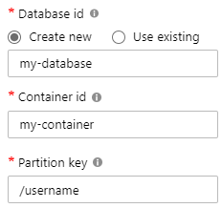
What is partitioning?
Andrew
Mark
Deborah
Tim
Luis
Theo
Notes:
“This is where the partition key really comes into play.
When we create a Cosmos DB container, we must specify a partition key. This is simply the name of a property in our documents. Cosmos DB reads that property’s value and uses it to determine which logical partition the document belongs to.”
“In this example, the partition key is /username.
So every document with the same username value is automatically grouped into the same logical partition.”
“If the username is ‘Andrew,’ all of Andrew’s documents live in one logical partition.
If the username is ‘Deborah,’ her documents go into a different logical partition, and the same applies for Tim, Luis, Theo, Mark, and so on.”
“We’re not manually organizing data — Cosmos DB does the grouping for us based on the partition key value.”
“Now that we know how documents are grouped into logical partitions, the next important question is: how big can these partitions get, and what limits should we be aware of?
Let’s look at partition size limits next.”

Slide 19
What is partitioning?
Max size: 2 MB
Max size: 20 GB
Notes:
“When we talk about partitioning in Cosmos DB, there are two very important size constraints we must keep in mind as we design our data model.”
“First — each individual document has a maximum size of 2 MB.
This means no single JSON document can exceed 2 MB in size. So if you were thinking about embedding extremely large arrays or binary data, Cosmos will stop you at that limit.”
“Second — each logical partition can store up to 20 GB of data.
That means all documents that share the same partition key value must fit within 20 GB. If our partition key is /username, then all documents for ‘Andrew’ must fit within a single 20 GB logical partition, all documents for ‘Deborah’ must fit within their own 20 GB partition, and so on.”
“These two limits are why choosing the right partition key matters — we need to make sure we’re not creating partitions that will grow too large over time.”
“And now that we understand the size limits of each partition, the next question is: what happens when a partition gets too hot — when too many requests are hitting the same partition?
Let’s move on to partition throughput and the concept of ‘hot partitions.’”

Slide 20

What is partitioning?
Notes:
“Now that we know partitions have size limits, there’s another important concept to understand: workload distribution.”
“What we want is for our data — and our traffic — to be evenly distributed across all logical partitions. That means reads and writes should ideally be spread out, so no single partition has to handle a disproportionate amount of work.”
“But in the example on the screen, one partition is receiving almost all the documents, while the others barely get anything. This situation is called a hot partition.
A hot partition becomes a performance bottleneck because Cosmos DB must throttle requests when one partition receives too much load. Even if the total throughput of the database is high, your workload slows down because one partition gets overwhelmed.”
“So the goal in partition design is to avoid this kind of imbalance and make sure your partition key helps spread the data and the traffic evenly.”
“Now let’s look at what happens on the query side — because the partition key not only affects where data is written, it also determines how efficiently we can read it.”

Slide 21
What is partitioning?
Notes:
“Just like data distribution, throughput distribution matters just as much.”
“Even if your documents are evenly spread across partitions, your requests might not be.
If most of your reads or writes end up targeting the same logical partition — like the one highlighted here — that partition becomes a throughput bottleneck.”
“Cosmos DB enforces throughput limits per partition.
So if one partition receives five times more traffic than the others, it will start throttling, even if your container has plenty of RU/s allocated overall.”
“This is another form of a hot partition: not because of data volume, but because of request volume. And this can severely limit the scalability of your model.”
“So now that we understand why evenly distributing both data and traffic matters, let’s look at how the partition key directly affects query performance — specifically, whether a query can target one partition or needs to fan out across all of them.”

Slide 22
What is partitioning?
Notes:
“At this point, the main takeaway is that a good partitioning strategy should give us a layout that looks like this.”
“We want both storage and throughput to be more or less evenly distributed across all logical partitions.
That means no single partition should accumulate too much data, and no single partition should receive a disproportionate number of requests.”
“When both data and traffic are balanced, Cosmos DB can scale out efficiently — each partition contributes evenly to overall throughput, and we avoid the bottlenecks caused by hot partitions.”
“Now that we know what ‘good’ looks like, let’s see how a well-designed partition key helps us achieve this — starting with how it affects query efficiency.”

Slide 23

What is partitioning?
Andrew
Deborah
Tim
Mark
Luis
Theo
SELECT * FROM c WHERE c.username = 'Mark'
our partition key
Notes:
“This slide shows why choosing the right partition key matters so much for both performance and scalability.”
“In this example, our container is partitioned by username. When we run a query such as:
SELECT * FROM c WHERE c.username = 'Mark'
Cosmos DB recognizes that username is the partition key, so it instantly knows exactly which single logical partition to target — the one containing Mark’s data.”
“This means the query touches only one logical partition, which typically lives on one physical server.
That’s extremely efficient because:
Only one partition is scanned — no cross-partition work
Latency is predictable
RUs consumed are low
Performance doesn’t degrade as your data grows
“This is one of the key benefits of good partition design: a single-partition query effectively decouples performance from total data size.”
“But… this only works when our queries line up with our partition key.
Let’s look at what happens when they don’t — and Cosmos is forced to fan the query out across every partition.”

Slide 24
What is partitioning?
Andrew
Deborah
Tim
Mark
Luis
Theo
SELECT * FROM c WHERE c.favoriteColor = 'orange'
?
Notes:
“Now let’s look at a query that does not use the partition key.”
“In this example, the query filters on favoriteColor = 'orange'.
The problem is: Cosmos DB has no idea which partition contains the orange documents, because favoriteColor is not our partition key.”
“So what happens? Cosmos DB is forced to fan out the query to every logical partition in the container.
That means it has to ask every single partition:
‘Do you have any orange documents?’”
“This still works — Cosmos DB will return the correct results — but there’s a cost:”
Higher latency because multiple partitions must be scanned
Higher RU consumption
Lower scalability because the number of partitions grows with your data
“And this cost only gets worse as your data scales, because the query must touch more and more partitions over time.”
“So ideally, we want to design our partition key in a way that avoids these expensive cross-partition queries as much as possible.
Next, let’s look at how we actually choose a good partition key for our customer model.”

Slide 25
Choosing a partition key for customers
{
"id": "…",
"title": "…",
"firstName": "…",
"lastName": "…",
"emailAddress": "…",
"phoneNumber": "…",
"creationDate": "…",
"addresses": [{
"addressLine1": "…",
"addressLine2": "…",
…
}],
"password": {
"hash": "…",
"salt": "…"
}
}
customers
PK: ?
Notes:
“Now that we understand how partitioning works — logical partitions, hot partitions, throughput distribution, and the impact of the partition key — the next question is: how do we choose the right partition key for our customer data?”
“Here we have a sample customer document. It contains properties like first name, last name, email, phone number, addresses, and so on.
But which one of these should we use as the partition key?
And more importantly… what makes a partition key good or bad?”
“To answer that, let’s take a step back and think about how this container will actually be used — what kinds of operations we’ll run most frequently.”

Slide 26
Choosing a partition key for customers
customers
PK: ?
Create a customer
Retrieve a customer
(by id)
Notes:
“To choose the right partition key, we always start by looking at how the data will actually be used.
For our customers container, the two core operations are very simple:
– Creating a customer
– Retrieving a customer by ID.”
“Creating a customer is a straightforward write, and retrieving a customer by ID is a very common read pattern. So our partition key should support these operations efficiently, without causing cross-partition queries.”
“With that in mind, let’s see what happens if we choose the customer ID as our partition key.”

Slide 27
Choosing a partition key for customers
customers
PK: id
Create a customer
Retrieve a customer
(by id)
Notes:
“So based on the operations we just reviewed, choosing id as the partition key actually makes a lot of sense.
Every time we create a new customer, they automatically get a unique ID.
And whenever we retrieve a customer, we always do it by ID as well.”
“This means every request naturally targets a single logical partition, which gives us predictable performance and avoids unnecessary cross-partition queries.
In other words, using the customer’s ID as the partition key aligns perfectly with how this data is accessed.”
“Now let’s visualize what this looks like when the data is actually distributed across partitions.”

Slide 28
Choosing a partition key for customers
customers
PK: id
Notes:
“Now, when we choose id as the partition key, something interesting happens:
we end up with as many logical partitions as we have customers.
Each customer gets their own logical partition with exactly one document inside.”
“And that’s perfectly okay.
People sometimes worry that having a very large number of logical partitions is a problem—but it isn’t.
Logical partitions are just a virtual concept. Cosmos DB automatically groups many logical partitions together on the same physical servers.
There’s no performance penalty, and there’s no upper limit on how many logical partitions you can have in a container.”
“So even though this diagram shows lots of little partitions, Cosmos DB handles all of this behind the scenes.
You never have to manage or balance them manually.”

Slide 29
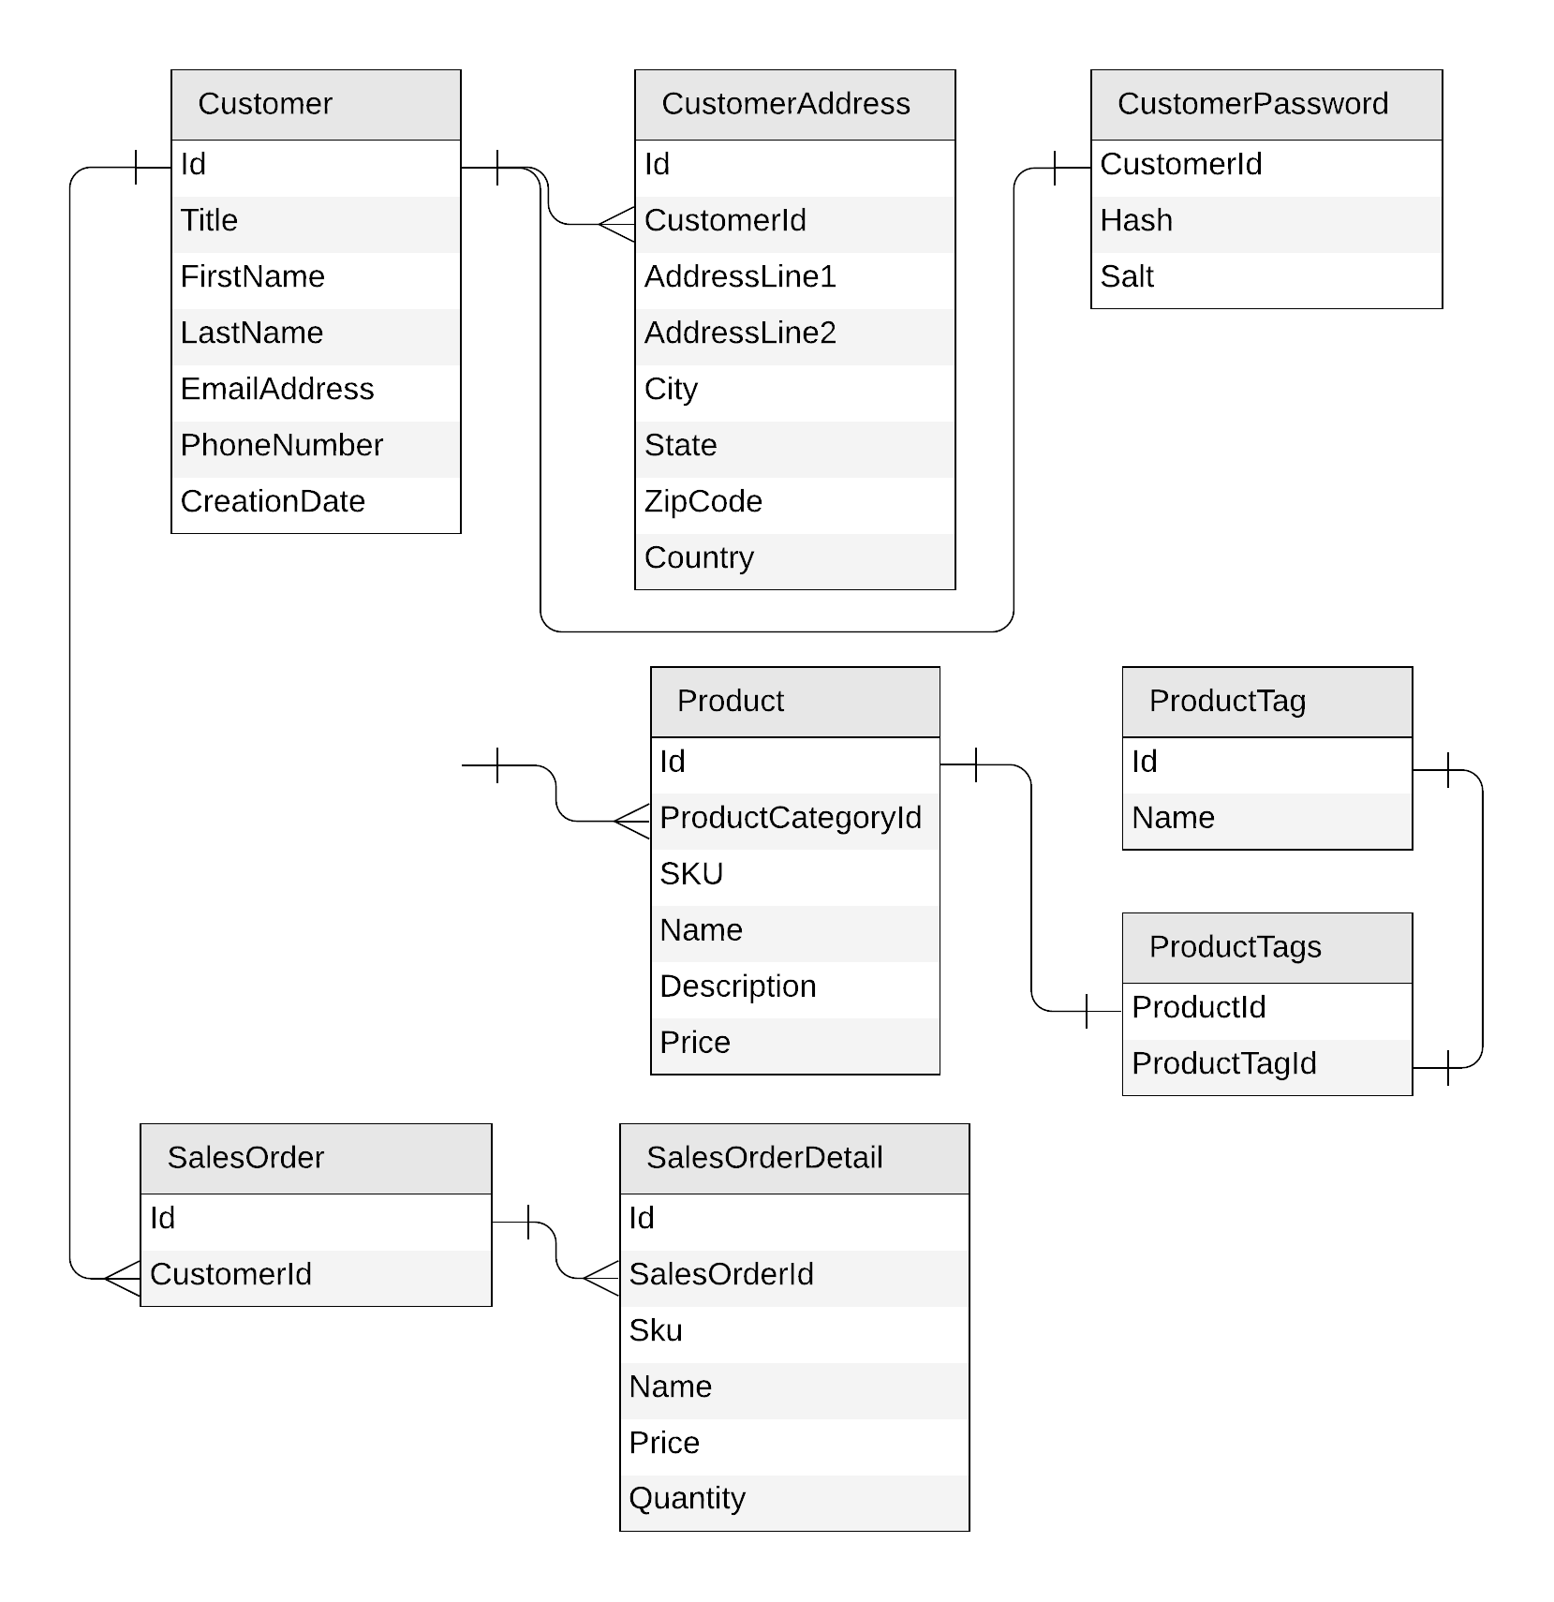
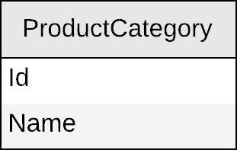
Next: product categories
Notes:
Now that we’ve walked through the customer entity and used it as our example to understand embedding, referencing, and partitioning, let’s move on to the next part of our data model: product categories.
On the screen here, you can see the relational diagram again. This helps us visualize where product categories sit in the overall domain.
In a traditional SQL model, product categories are connected to products through a simple one-to-many relationship—one category can contain many products.
As we transition into Cosmos DB, we'll think about how to model this entity in a document-oriented world and, importantly, how to choose an appropriate partition key based on the operations our application needs to support.”**
Transition:
“With that context in mind, let’s take a closer look at how we should store product categories inside Cosmos DB.”

Slide 30
Product categories
{
"id": "…",
"name": "…"
}
Notes:
“Let’s move on to product categories.
This one is very simple — the relational table has just two fields: id and name.
So we translate it directly into a small JSON document with those same fields.”
Transition:
“Next, let’s see how we store these categories in a container and think about the right partition key.”

Slide 31
Product categories
productCategories
PK: ?
{
"id": "…",
"name": "…"
}
Notes:
“Now that we have the JSON document for a product category, we need a place to store it.
So we create a new container called productCategories.
The only question left is: what should the partition key be?”
Transition:
“To figure that out, let’s look at the operations we’ll perform on product categories.”

Slide 32
Product categories
productCategories
PK: ?
Create a product category
Edit a product category
List all product categories
SELECT * FROM c
Notes:
**“Now let’s think about the operations we need to support for product categories.
We need to create a category, edit a category, and—most importantly—list all categories.
That last operation usually means running a query like SELECT * FROM c, which returns everything in the container.
To make that query fast and single-partition, all product categories should ideally live in the same logical partition.”**
Transition:
“So knowing that we always read all categories together, what partition key should we choose?”

Slide 33
Product categories
productCategories
PK: type
{
"id": "…",
"name": "…",
"type": "category"
}
Notes:
o make the SELECT * FROM c query single-partition, we need all product categories to live in the same logical partition.
One simple trick is to introduce a field that has the same value for every category.
Here, we add a property called type, and we set it to 'category' for every document.
That means we can use type as the partition key, and all documents will automatically land in the same logical partition.”**
Transition:
“This approach might look a little strange at first, but we’ll refine and optimize this design as we move forward. Next, let’s apply the same thinking to product tags.”

Slide 34
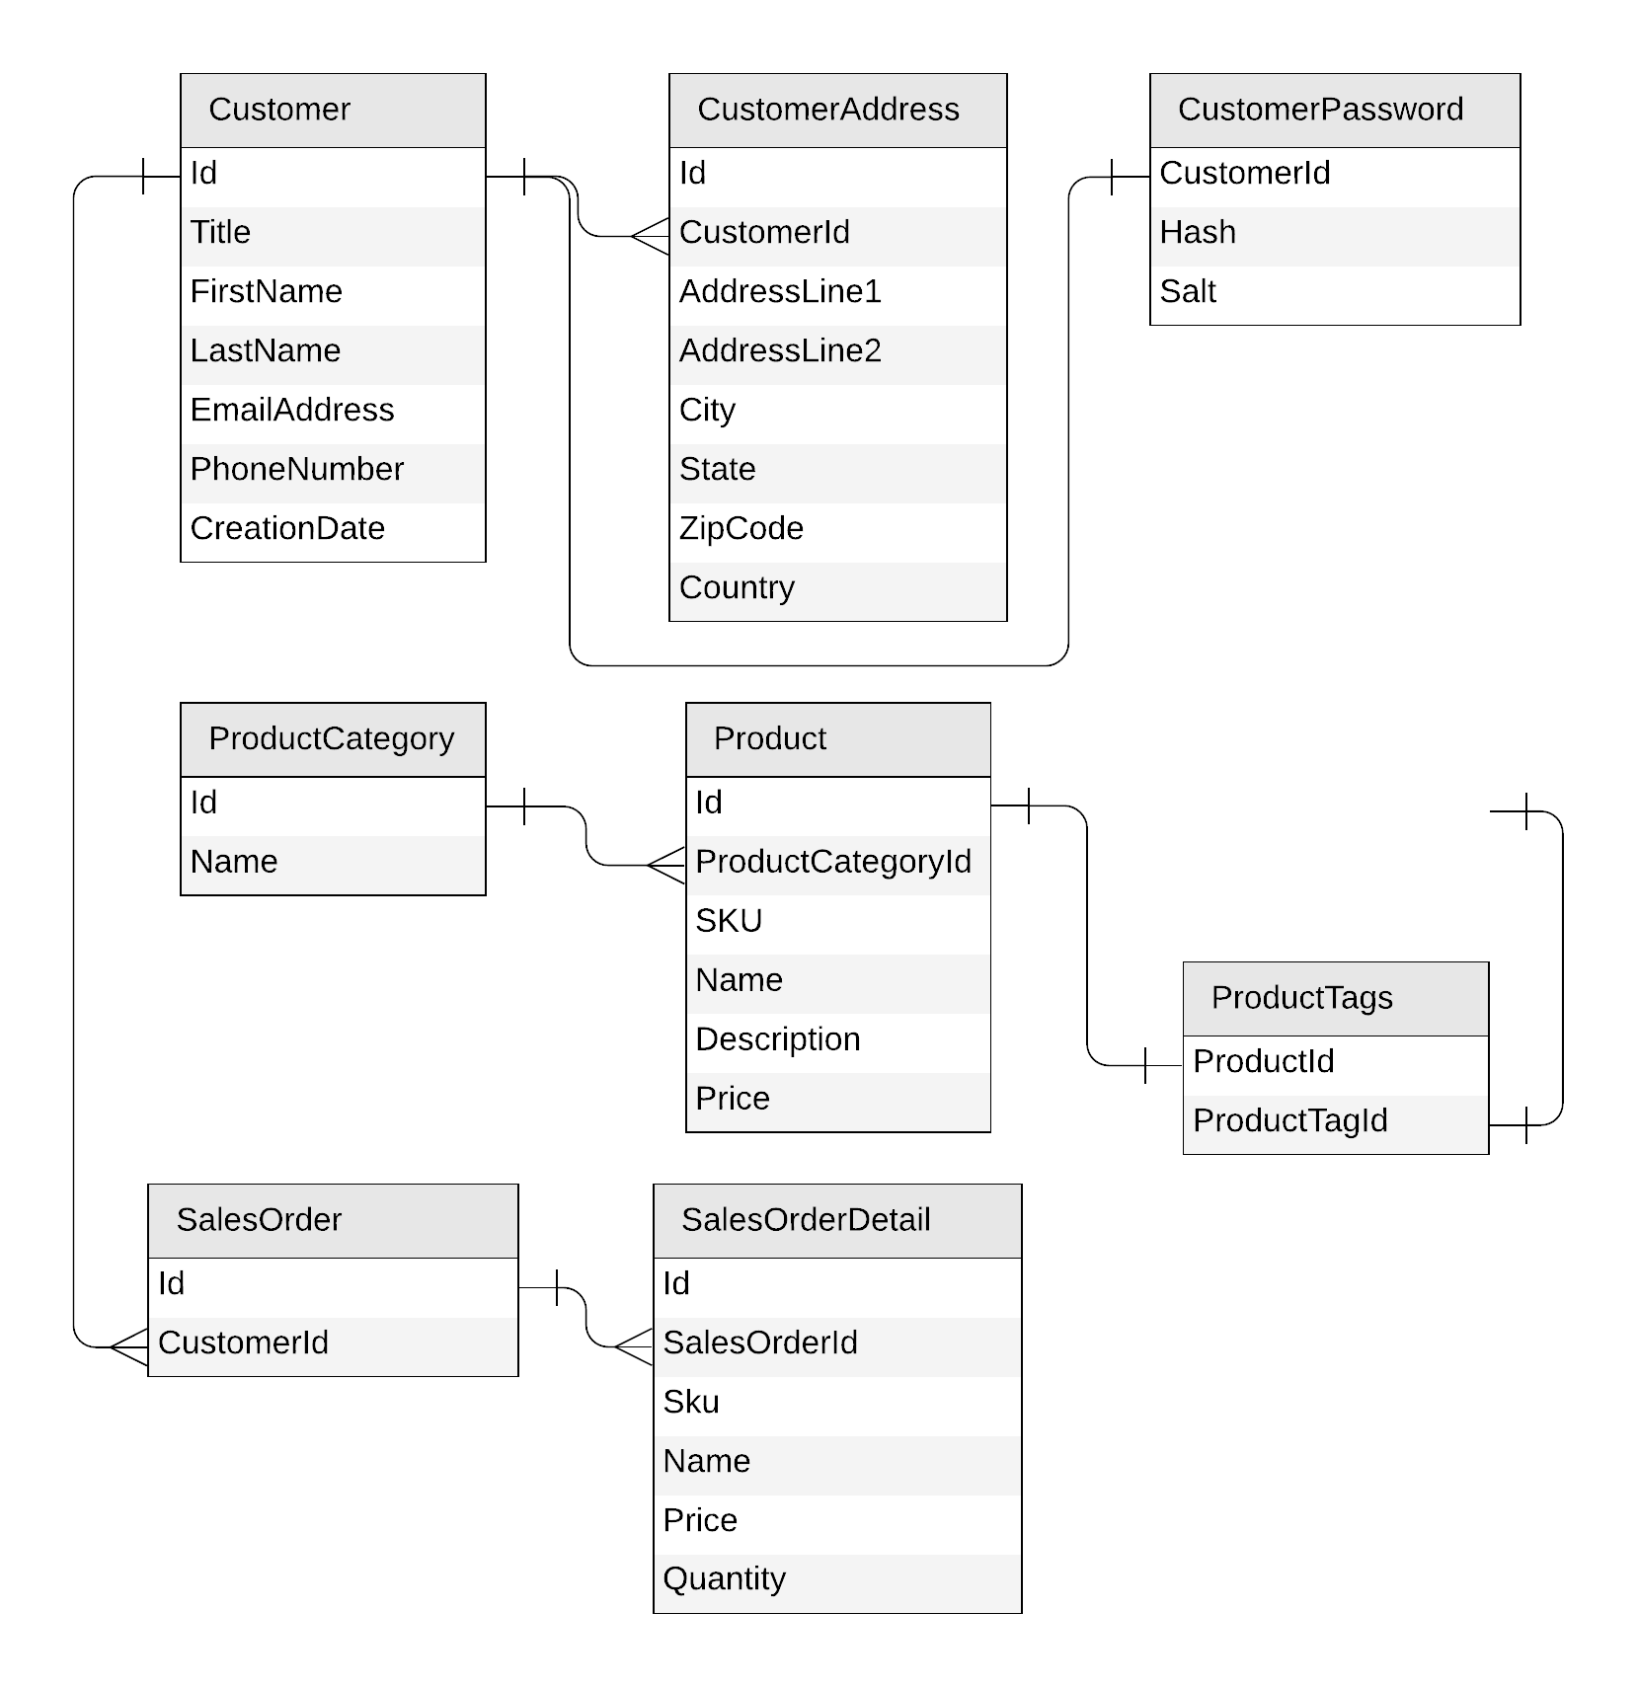
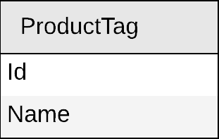
Next: product tags
Notes:
“Now that we’ve finished designing product categories, let’s move on to the next entity in our data model: product tags.
Just like before, we start by looking at how tags fit into the relational diagram—how they relate to products and how they’re used in the system.”
Transition:
“With that context in mind, let’s translate this entity into a JSON document and think about how we’ll store it in Cosmos DB.”

Slide 35
Product tags
{
"id": "…",
"name": "…"
}
Notes:
Applying the same process for product tags, we start by defining the JSON document.

Slide 36
Product tags
productTags
PK: ?
{
"id": "…",
"name": "…"
}
Notes:
We will store tags in their own container named 'productTags'.

Slide 37
Product tags
productTags
PK: ?
Create a product tag
Edit a product tag
List all product tags
Notes:
**“Now let’s look at product tags.
When we examine the operations we need to support—creating a tag, editing a tag, and listing all tags—we notice something interesting: tags follow the exact same access patterns as product categories.
Because of that, we can apply the very same partitioning strategy here as well.”**
Transition:
“So let’s use that approach and see what the resulting document and partition key would look like.”

Slide 38
Product tags
productTags
PK: type
{
"id": "…",
"name": "…",
"type": "tag"
}
Notes:
Which is partitioning the container by 'type', which will be set to 'tag' in each document.

Slide 39
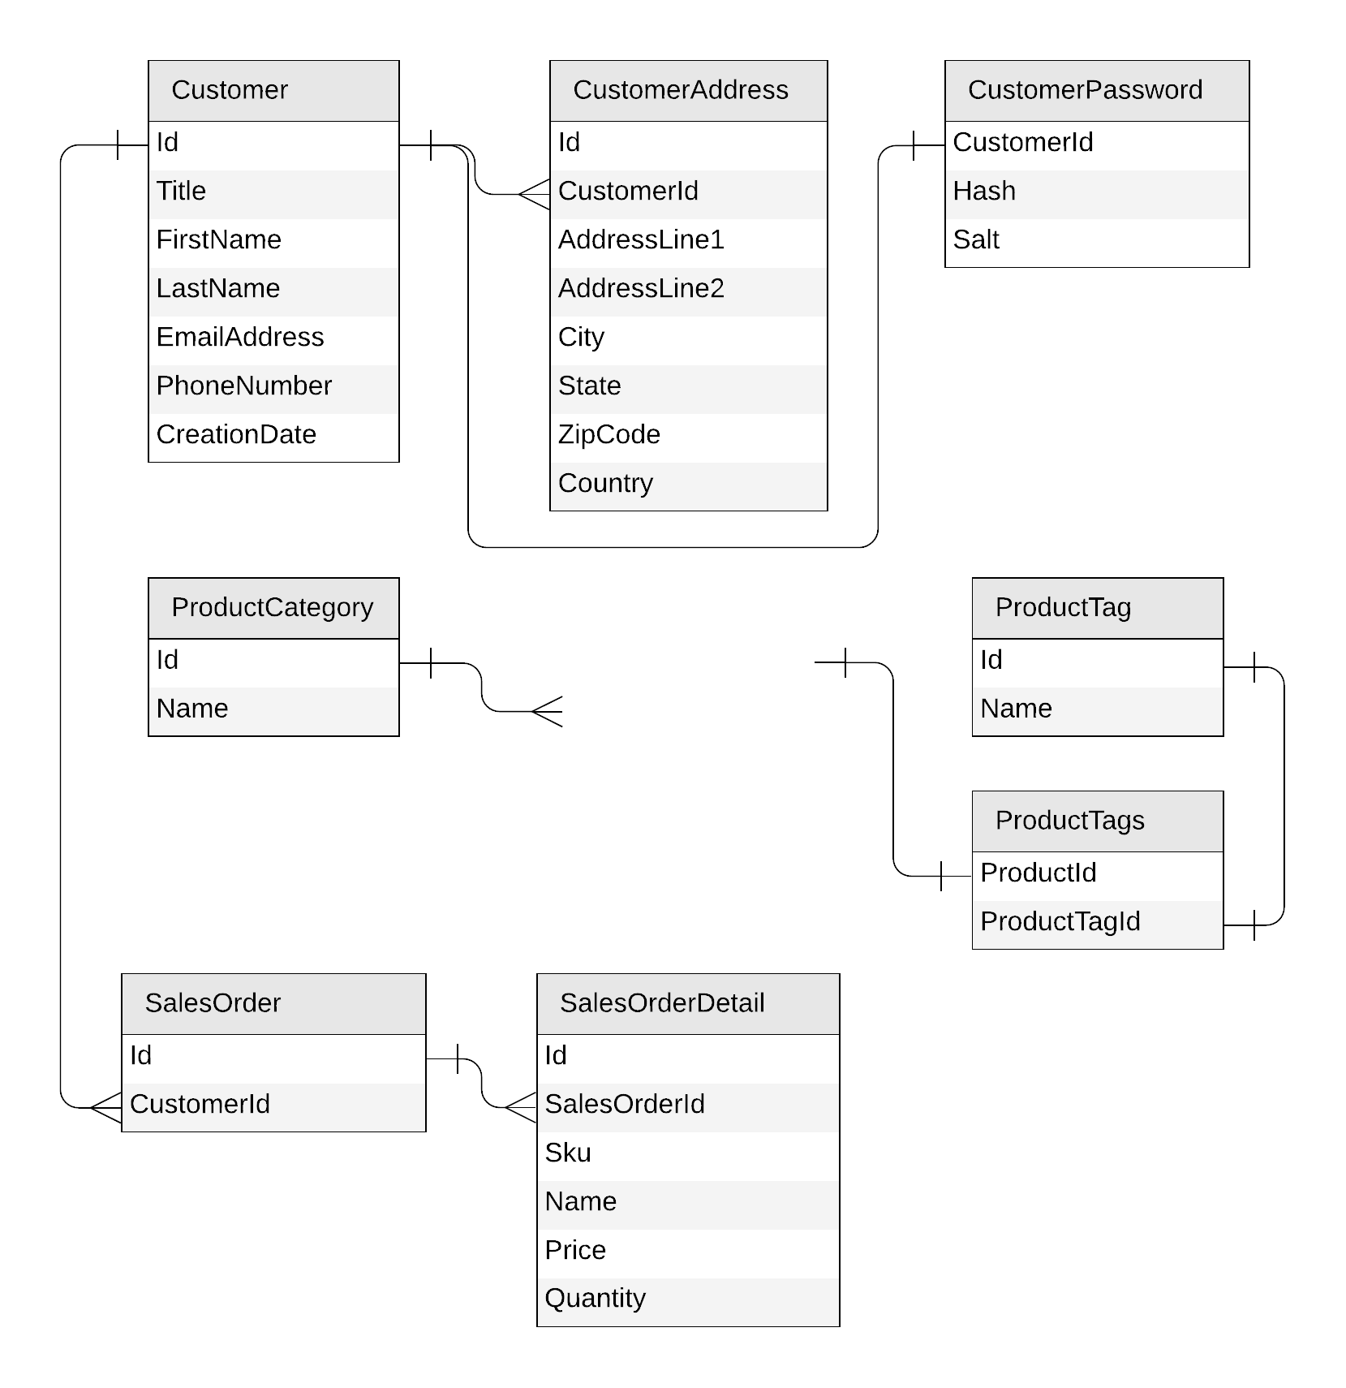
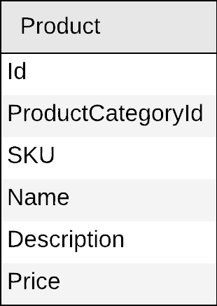
Next: products

Slide 40
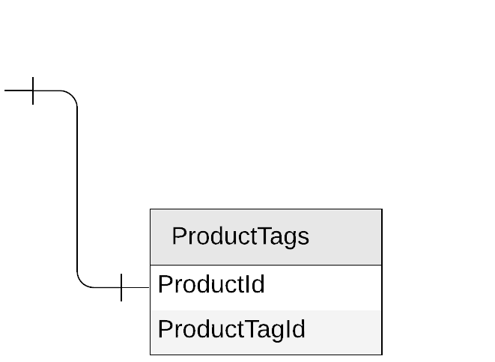
Products
{
"id": "…",
"categoryId": "…",
"sku": "…",
"name": "…",
"description": "…",
"price": …
}
Notes:
Next, let's look at our products!

Slide 41
Products
{
"id": "…",
"categoryId": "…",
"sku": "…",
"name": "…",
"description": "…",
"price": …,
"tagIds": [
"…",
"…"
]
}
Notes:
**“Now let’s move on to Products.
Just like before, we start by translating the relational schema into a JSON document. So we include all the expected fields: id, categoryId, SKU, name, description, price, and so on.
But there’s one extra piece we need to account for: the relationship with tags.
Since a product can have several tags — a 1-to-few relationship — the simplest and most efficient approach is to embed a list of tag IDs directly inside each product document.”**
Transition:
“With that structure defined, the next step is to think about how we want to store these products inside a container — and specifically, which partition key will give us the best performance.”

Slide 42
Products
{
"id": "…",
"categoryId": "…",
"sku": "…",
"name": "…",
"description": "…",
"price": …,
"tagIds": [
"…",
"…"
]
}
products
PK: ?
Notes:
We'll store products in their own container, named 'products'.

Slide 43
Products
Create a product
Edit a product
List all products from a category
(with name of category and tags)
products
PK: ?
SELECT * FROM c WHERE c.categoryId = 'CategoryA'
CategoryA
CategoryB
CategoryC
Notes:
**“Now let’s look at the access patterns for products so we can choose the right partition key.
For products, we need to support three main operations: creating a product, editing a product, and retrieving all products that belong to a specific category — including showing the category name and the tag names.
The key query here is the one at the bottom:
SELECT * FROM c WHERE c.categoryId = 'CategoryA'
This query returns all products for a given category.
To make this query efficient — meaning it hits only one logical partition — all products that belong to the same category must be stored in the same partition.
That naturally points us toward using categoryId as the partition key, because it groups all products from the same category together and keeps this query single-partition.”**
Transition:
“But that raises another question: how do we return the category name and the tag names if Cosmos DB doesn’t support joins? Let’s take a look at that next.”

Slide 44
Products
{
"id": "…",
"categoryId": "…",
"sku": "…",
"name": "…",
"description": "…",
"price": …,
"tagIds": [
"…",
"…"
]
}
category name?
products
PK: categoryId
tag names?
Notes:
**“We decided that categoryId is the right partition key because it lets us retrieve all products for a category quickly.
But there's still a problem: when I query a product, I only get IDs — the categoryId and a list of tagIds.
What I really need to show in the application is the category name and the tag names.
In a relational database, I would solve this with joins.
But in Cosmos DB, we can't perform joins across containers.
So this is where we need to think about how to make that data available in a single query response.”**
Transition:
“To solve this, we move into one of the most important concepts in NoSQL design: denormalization.”

Slide 45

Products: how to return category and tag names?
products
SELECT * FROM c WHERE c.categoryId = 'CategoryA'
productCategories
WHERE ARE MY JOINS?
SELECT c.name FROM c WHERE c.id = 'CategoryA'
productTags
SELECT * FROM c
WHERE c.id IN ('<tagId1>', '<tagId2>', '<tagId3>')
Notes:
**“Now we run into the classic problem: how do we return the category name and tag names for each product?
If this were a relational database, we’d just write a JOIN. But in Cosmos DB, containers don’t support cross-container joins.
So the only way to do this in a normalized model is to run multiple queries:
• First query: get all products for the category.
• Second query: look up the category name.
• Third query: for each product, fetch its tag names.
This technically works — but it’s slow, it’s expensive, and it doesn’t scale.
Anyone coming from SQL is going to say, ‘Where are my JOINs?’
This is exactly why we need to think differently in NoSQL and start optimizing the data model for the queries we need to serve.”**
Transition:
“And that leads us into denormalization — one of the most important concepts in non-relational modeling.”

Slide 46
Introducing denormalization
When working with non-relational databases, we optimize our data models to make sure that all the required data is ready to be served by the queries

Slide 47
Products: denormalizing category and tag names
{
"id": "…",
"categoryId": "…",
"categoryName": "…",
"sku": "…",
"name": "…",
"description": "…",
"price": …,
"tags": [
{
"id": "…"
"name": "…"
},
{
"id": "…"
"name": "…"
},
]
}
products
PK: categoryId
Notes:
**“To avoid all those extra queries and missing JOINs, we denormalize.
That means we store the data we need directly inside the product document.
So instead of returning only a category ID and tag IDs, we also embed:
• the category name,
• and for each tag, both its ID and its name.
By doing this, a single read from the products container gives us everything the UI needs — no lookups, no joins, no fan-out queries.
This works great for read performance…
But now we have a new challenge: what happens if someone renames a category or a tag?
All the products that copied that name would now be out of sync.
And that’s why we need to think about keeping everything consistent.”**
Transition:
“So let’s talk about how we keep these denormalized fields in sync — and that’s where Cosmos DB’s change feed comes in.”

Slide 48
Products: keeping everything in sync
productCategories
ProductCategory
products
Product
productTags
ProductTag
Notes:
**“Now that we're denormalizing category and tag names into each product, we need a way to keep everything consistent.
If someone renames a category or a tag, we want that change to automatically flow into every product that uses it.
That means:
• when a category name changes → update all products in that category
• when a tag name changes → update all products that contain that tag
So the goal is simple: any update in the productCategories or productTags containers should be reflected in the products container as well, without us manually touching every document.”**
Transition:
“And this is exactly what Cosmos DB’s change feed is designed for — so let’s look at how it helps us keep everything in sync.”

Slide 49

Cosmos DB's change feed
The change feed is an API exposed by Cosmos DB containers
It streams any change happening in a container (document creation or update)
Notes:
**“To keep our products in sync when a category or tag changes, Cosmos DB gives us exactly the feature we need: the change feed.
The change feed is basically a stream of every change that happens inside a container — any insert, any update.
So whenever a category or tag is modified, the change feed will automatically surface that event.
We can then listen to those events and update the corresponding products right away, keeping everything consistent.”**
Transition:
“Now let’s see how we use the change feed to push those updates into the products container.”

Slide 50

Products: keeping everything in sync
productCategories
products
productTags
Notes:
**“To keep everything synchronized, we add two small Azure Functions — one watching the category container and one watching the tag container.
Each function listens to the change feed for its container.
Whenever a category or tag is updated, the function picks up that change and immediately updates all related products.
This ensures that product documents always contain the latest category name and tag names without requiring joins.”**
Transition:
“Now that products, categories, and tags stay in sync, let’s move on to sales orders.”

Slide 51
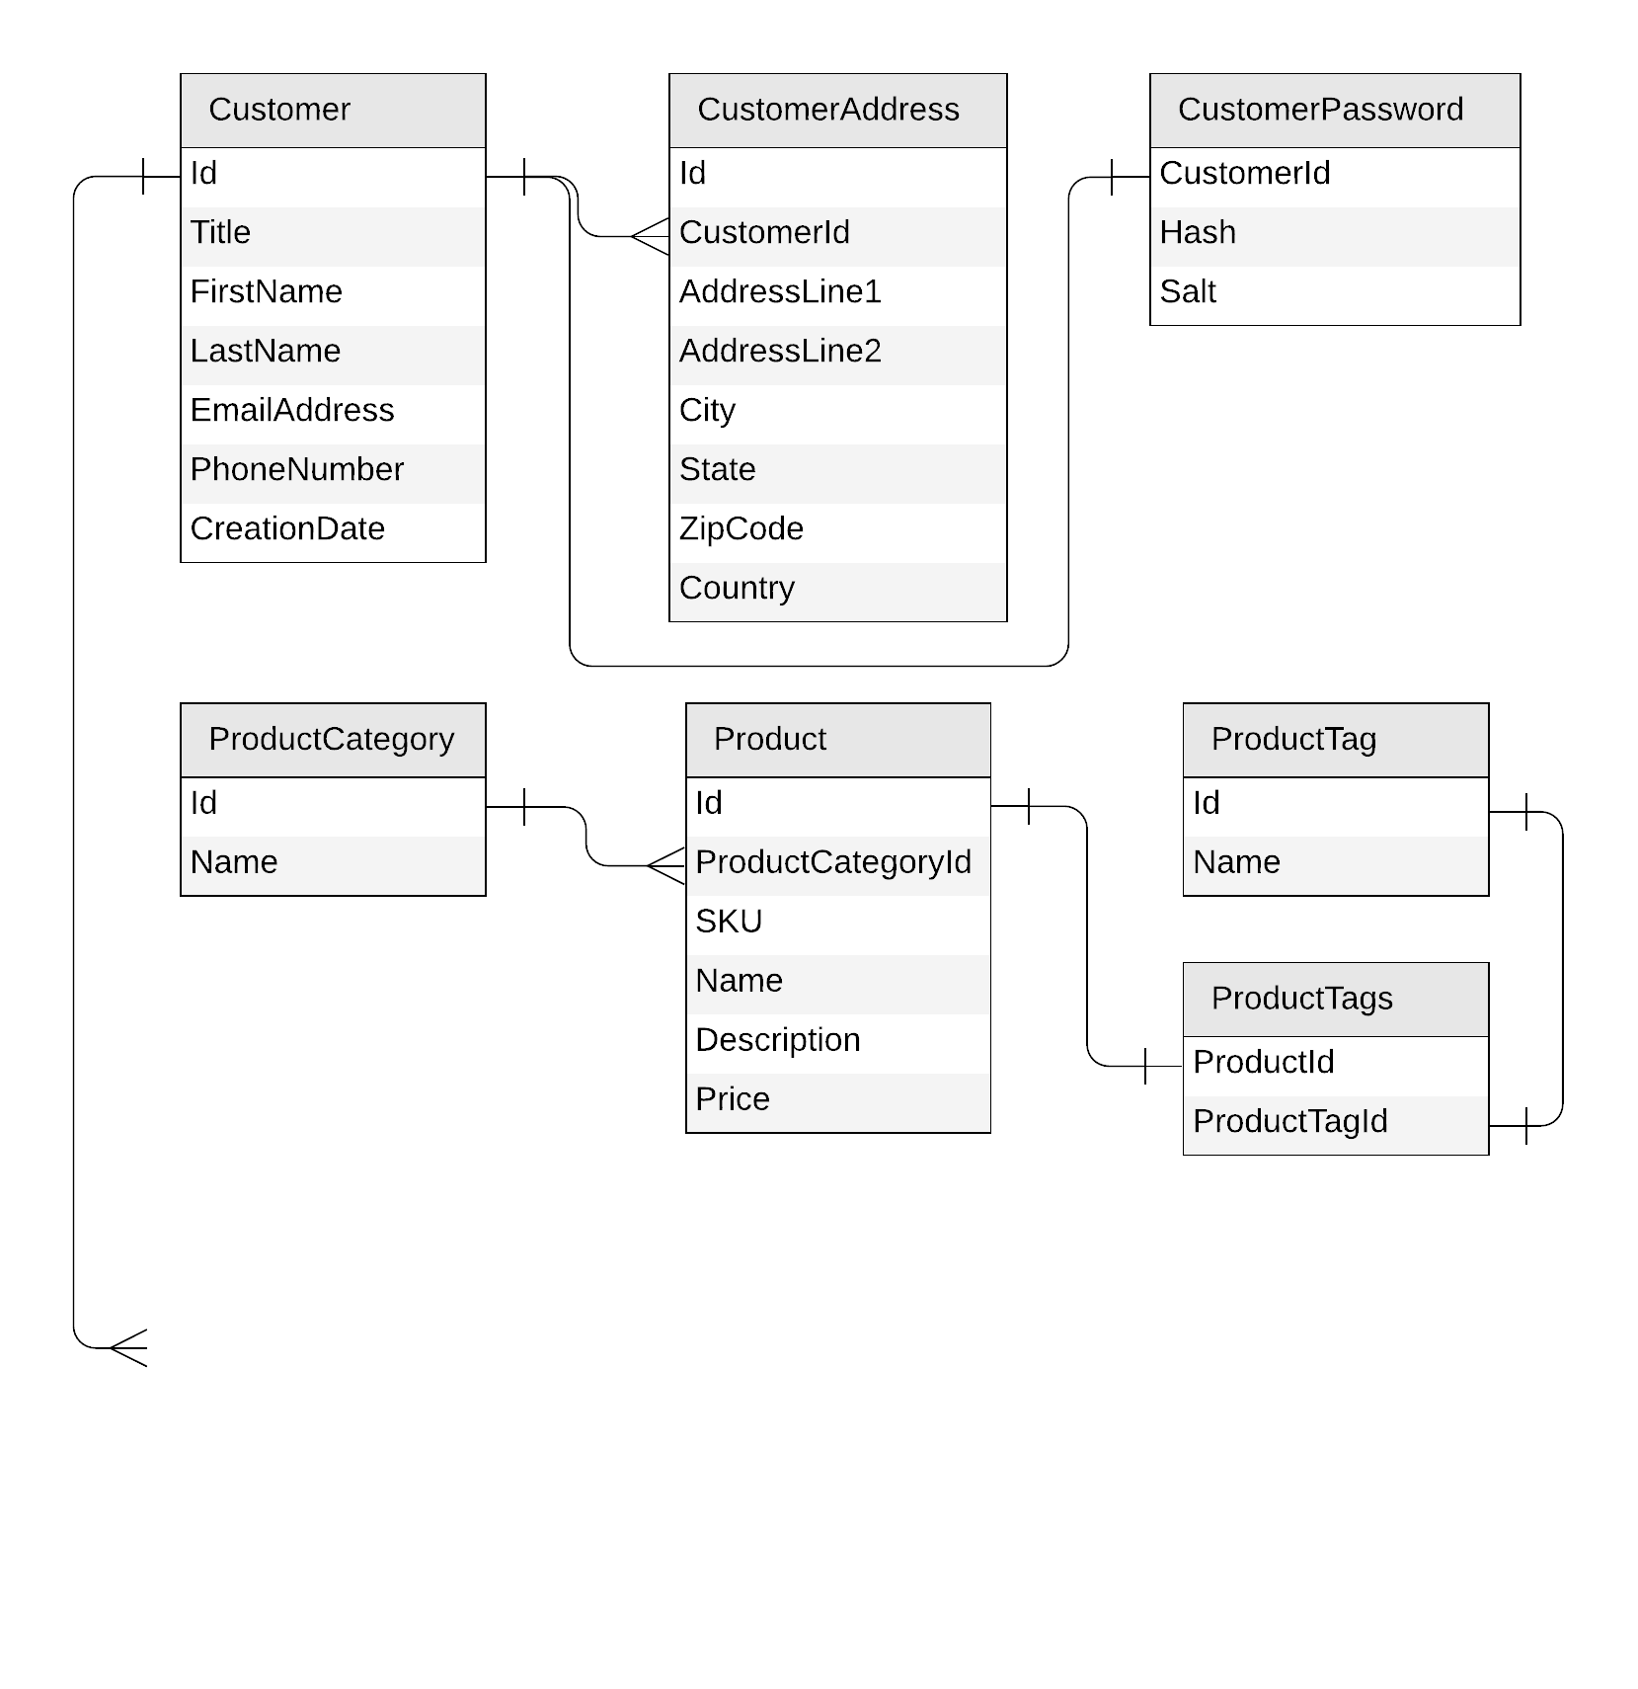
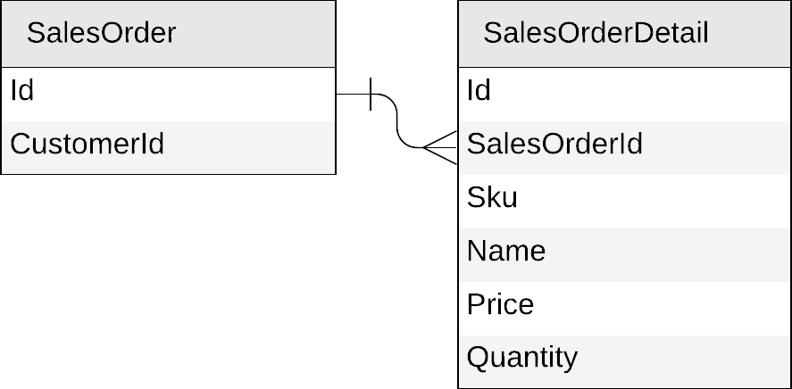
Next: sales orders

Slide 52
Sales orders
{
"id": "…",
"customerId": "…"
}
{
"id": "…",
"salesOrderId": "…",
"sku": "…",
"name": "…",
"description": "…",
"price": …,
"quantity": …
}
Notes:
Lastly, let's look at our sales order.
Same process, we start by creating the JSON form of each entity.

Slide 53
Sales orders
{
"id": "…",
"customerId": "…",
"details": [{
"sku": "…",
"name": "…",
"description": "…",
"price": …,
"quantity": …
}]
}
Notes:
This is obviously another good candidate for embedding, as it makes sense to embed the sales order details together with the sales order.

Slide 54
Sales orders
{
"id": "…",
"customerId": "…",
"details": [{
"sku": "…",
"name": "…",
"description": "…",
"price": …,
"quantity": …
}]
}
salesOrders
PK: ?
Notes:
We could store sales orders in their own container.

Slide 55
Sales orders
salesOrders
PK: ?
Create a sales order
List all sales order for a customer
List customers by descending number of sales orders
Notes:
And again, we look at the expected requests to decide on the partition key.

Slide 56
Sales orders
salesOrders
PK: ?
Create a sales order
List all sales order for a customer
SELECT * FROM c WHERE c.customerId = 'CustomerA'
CustomerA
CustomerB
CustomerC
Notes:
“Now let’s look at sales orders.
One of the key operations we need to support is listing all sales orders for a specific customer.
To do that efficiently, we want the query:
SELECT * FROM c WHERE c.customerId = 'CustomerA'
to be a single-partition query.
That means all sales orders belonging to the same customer must live in the same logical partition.
So naturally, customerId becomes the right partition key for the salesOrders container.
This way, creating a new sales order and retrieving every order for a given customer are both optimized and scalable.”

Slide 57
Sales orders
{
"id": "…",
"customerId": "…",
"details": [{
"sku": "…",
"name": "…",
"description": "…",
"price": …,
"quantity": …
}]
}
salesOrders
PK: customerId
Notes:
So customerId would be a suitable partition key here.

Slide 58
Sales orders
{
"id": "…",
"customerId": "…",
"details": [{
"sku": "…",
"name": "…",
"description": "…",
"price": …,
"quantity": …
}]
}
salesOrders
PK: customerId
{
"id": "…",
"title": "…",
"firstName": "…",
"lastName": "…",
"emailAddress": "…",
"phoneNumber": "…",
…
}
customers
PK: id
Notes:
**“Before we go further, let’s take a quick step back.
If we look at all the containers we’ve created so far, something interesting shows up: we already have a container that’s partitioned by customerId — our customers container.
And this is the exact same partition key we just selected for sales orders.
So that raises a natural question: if both entity types share the same partition key, could we store customers and sales orders together in the same container?”**
“This brings us to an important capability of Cosmos DB: the ability to mix different entity types in the same container when it benefits our access patterns.”

Slide 59
Mixing entities in the same container?
Leverage the schema-agnostic nature of Cosmos DB
Suitable when different entity types
  share similar access patterns
  share the same partition key
Notes:
**“So now that we’ve noticed both customers and sales orders share the same partition key, let’s talk about a powerful capability of Cosmos DB.
Cosmos DB is completely schema-agnostic, meaning it doesn’t require every item in a container to follow the same shape or structure.
Because of that, we can store different entity types together in the same container—as long as it makes sense for our access patterns.
This approach works well when two entity types:
• share similar access patterns, and
• share the same partition key.
And conveniently, both of those are true for customers and sales orders.”**

Slide 60
Sales orders
{
"id": "…",
"customerId": "…",
"details": [{
"sku": "…",
"name": "…",
"description": "…",
"price": …,
"quantity": …
}]
}
salesOrders
PK: customerId
{
"id": "…",
"title": "…",
"firstName": "…",
"lastName": "…",
"emailAddress": "…",
"phoneNumber": "…",
…
}
customers
PK: id
Notes:
So instead of storing customers and sales orders in the same container

Slide 61
Sales orders: mixing with customers
{
"id": "…",
"customerId": "…",
"details": [{
"sku": "…",
"name": "…",
"description": "…",
"price": …,
"quantity": …
}]
}
customers
PK: id
{
"id": "…",
"title": "…",
"firstName": "…",
"lastName": "…",
"emailAddress": "…",
"phoneNumber": "…",
…
}
Notes:
We're going to put them both in the customers container.

Slide 62
Sales orders: mixing with customers
{
"id": "…",
"customerId": "…",
"details": [{
"sku": "…",
"name": "…",
"description": "…",
"price": …,
"quantity": …
}]
}
customers
PK: customerId
{
"id": "…",
"customerId": "…",
"title": "…",
"firstName": "…",
"lastName": "…",
"emailAddress": "…",
"phoneNumber": "…",
…
}
Notes:
**“So if we want to store customers and sales orders together in the same container, we just need to make a couple of small adjustments.
First, we’ll change the container’s partition key from id to customerId.
That way, both customers and their sales orders naturally land in the same logical partition.
Second, we add a customerId field to the customer document itself.
That ensures every item we store—customers or orders—has the same partition key value available.
And for customer documents, id and customerId will simply carry the exact same value.”**

Slide 63
Sales orders: mixing with customers
{
"id": "…",
"type": "salesOrder",
"customerId": "…",
"details": [{
"sku": "…",
"name": "…",
"description": "…",
"price": …,
"quantity": …
}]
}
customers
PK: customerId
{
"id": "…",
"type": "customer",
"customerId": "…",
"title": "…",
"firstName": "…",
"lastName": "…",
"emailAddress": "…",
"phoneNumber": "…",
…
}
Notes:
**“Now that customers and sales orders live in the same container and share the same partition key, we need one more thing to make querying easier.
We add a simple type property to each document.
This lets us distinguish customers from sales orders when we query the container—because even though they share the same partition, we still want to filter them independently.
So a sales order will have type: "salesOrder" and a customer will have type: "customer".
This tiny addition makes our queries clean, predictable, and efficient.”**

Slide 64
Sales orders: mixing with customers
customer
sales orders
customers
PK: customerId
CustomerA
CustomerB
CustomerC
Notes:
**“Let me clarify what our container now looks like.
Since we’re partitioning by customerId, each logical partition will represent exactly one customer — and all of that customer’s sales orders.
So Customer A has their customer document and all their orders in one partition.
Same for Customer B, Customer C, and so on.
This means any query that needs ‘all orders for a customer’ stays within a single partition, giving us predictable and efficient performance.”**

Slide 65
Sales orders
customers
PK: customerId
Create a sales order
List all sales order for a customer
SELECT * FROM c WHERE c.customerId = 'CustomerA' AND c.type = 'salesOrder'
Notes:
**“Now that customers and their sales orders live in the same logical partition, querying becomes very straightforward.
If I want all sales orders for Customer A, I simply filter by customerId and by type = 'salesOrder'.
This gives me exactly the documents I need, all from a single partition, which keeps the query fast and predictable.”**

Slide 66
Sales orders
customers
PK: customerId
Create a sales order
List all sales order for a customer
List customers by descending number of sales orders
Notes:
**“Now we’ve covered how to create a sales order and how to list all sales orders for a customer.
There’s one more requirement we need to support: listing customers by the number of sales orders they’ve placed.
To do that, we need to count the sales orders for each customer, sort the customers by that count, and then return the matching customer documents.
But even though customers and sales orders now live in the same container, this type of aggregation isn’t something Cosmos DB can express directly in its query language.”**

Slide 67
Denormalizing the count of sales orders per customer
{
"id": "…",
"type": "customer",
"customerId": "…",
"title": "…",
"firstName": "…",
"lastName": "…",
"emailAddress": "…",
"phoneNumber": "…",
"creationDate": "…",
"addresses": [{
"addressLine1": "…",
"addressLine2": "…",
…
}],
"password": {
"hash": "…",
"salt": "…"
}
}
Notes:
Once again, the solution is to denormalize.

Slide 68
Denormalizing the count of sales orders per customer
{
"id": "…",
"type": "customer",
"customerId": "…",
"title": "…",
"firstName": "…",
"lastName": "…",
"emailAddress": "…",
"phoneNumber": "…",
"creationDate": "…",
"addresses": [{
"addressLine1": "…",
"addressLine2": "…",
…
}],
"password": {
"hash": "…",
"salt": "…"
},
"salesOrderCount": …
}
Notes:
“To handle this requirement, we’re going to denormalize the number of sales orders directly into the customer document.
That means each customer will store a field like salesOrderCount, which we’ll keep updated whenever new orders are created.
This lets us sort customers by order count quickly without needing complex queries.”

Slide 69
Denormalizing the count of sales orders per customer
customer
sales orders
customers
PK: customerId
CustomerA
CustomerB
CustomerC
Notes:
So what we want to achieve is that…

Slide 70
Denormalizing the count of sales orders per customer
update the customer
add a sales order
customers
PK: customerId
CustomerA
CustomerB
CustomerC
Notes:
Every time we add a sales order, we also update the corresponding customer to increment its count of sales orders.

Slide 71
Denormalizing the count of sales orders per customer
update the customer
add a sales order
function createSalesOrder(order) {
var collection = getContext().getCollection();
collection.readDocument(
`${collection.getAltLink()}/docs/${order.customerId}`,
function (err, customer) {
if (err) throw err;
customer.salesOrderCount++;
collection.replaceDocument(
customer._self,
customer,
function (err) {
if (err) throw err;
collection.createDocument(
collection.getSelfLink(),
order);
}
);
})
}
CustomerA
CustomerB
CustomerC
Notes:
“Because customers and their sales orders now live in the same logical partition, we can take advantage of Cosmos DB’s transactional capabilities.
This means we can update the customer document and create a new sales order document together, in a single atomic operation.”
“So instead of just inserting a new sales order on its own, we call a stored procedure.
That stored procedure does two things at once: it increments the customer’s salesOrderCount, and it adds the new sales order document.
Both updates succeed or fail together, ensuring the data stays perfectly consistent.”

Slide 72
Sales orders
customers
PK: customerId
Create a sales order
List all sales order for a customer
List customers by descending number of sales orders
SELECT * FROM c WHERE c.type = 'customer'
ORDER BY c.salesOrderCount DESC
Notes:
“Now that each customer document includes a salesOrderCount, we can finally answer the last request:
list customers by the number of sales orders they’ve placed.”
“Since the count is already denormalized into the customer document, the query becomes very simple.
We just filter for customers and order them by salesOrderCount in descending order.”
“And just like that, what used to be an expensive cross-document aggregation becomes a fast, single-partition query.”

Slide 73
Our final design
customers
PK: customerId
Customer
productTags
PK: type
ProductTag
SalesOrder
products
PK: categoryId
productCategories
PK: type
Product
ProductCategory
Notes:
Throughout this exercise, we've created the following container to support our design.
Note that there is an opportunity for a quick optimization here: because categories and tags share the same partition key…

Slide 74
Our final design, optimized!
customers
PK: customerId
Customer
SalesOrder
productMeta
PK: type
ProductTag
ProductCategory
products
PK: categoryId
Product
Notes:
We can just group them together in the same container, which we would rename to 'productMeta'.

Slide 75
Key takeaways
Identify key access patterns and design for them
Partitioning is critical for best performance and scalability
Materialize relations between entities by:
  Embedding
  Denormalizing and pre-aggregating
  Storing related entities in the same container
Different methods to implement denormalization
  Using the change feed
  Using stored procedures

Slide 76
Going further
aka.ms/PracticalCosmosDB
azurecosmosdb.com

